Slide 1
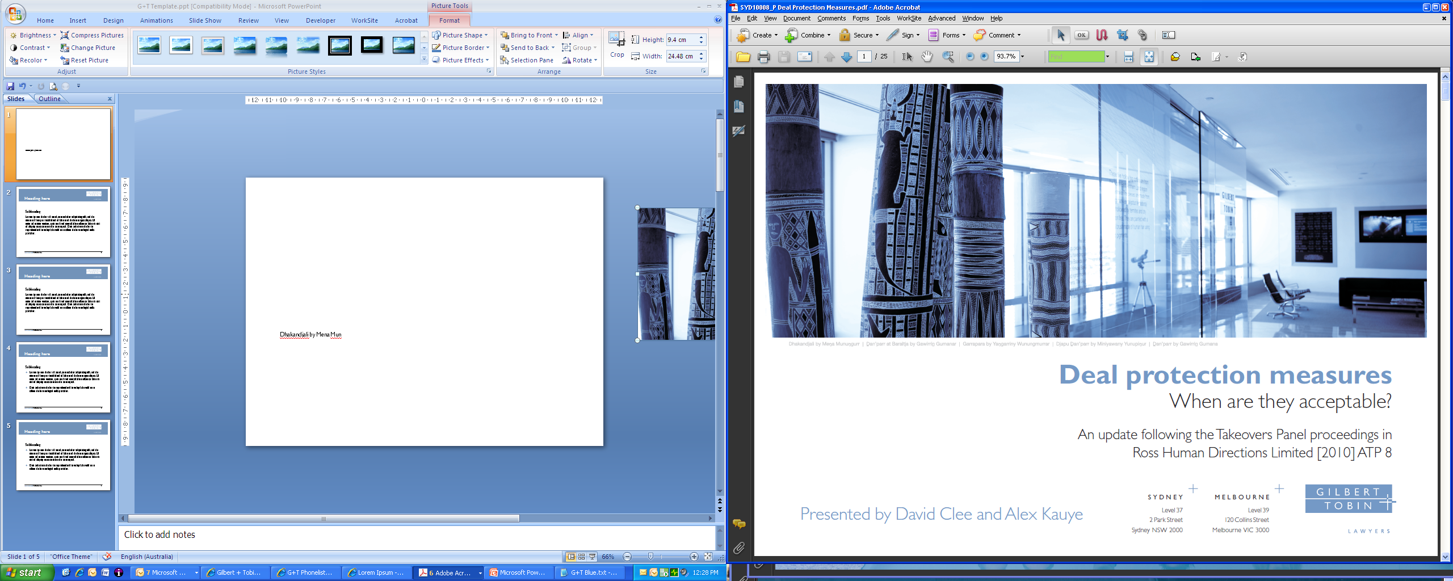
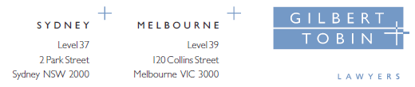
Recent Developments in Australian Competition Law
A Practitioner’s Perspective on International Enforcement Cooperation
Not for quotation.
June 2013
Luke Woodward

Slide 2
Many Competition Issues are Transnational
Businesses provide goods and services
  in international markets, eg commodities
  in bilateral or two sided country markets, eg aviation
  or simply import/export across countries
Some MNC’s operate directly in many countries
  matrix structures, Head Office, Regional HQ’s and Local Management
  Head Office and Regional HQ’s make decisions that apply in other countries
Others may operate in your market through local agents/distributors

Slide 3
Implications for Competition Enforcement
Conduct that affects your markets may be undertaken by businesses in other countries
  mergers, cartels, dominance, distribution arrangements
Business people are mobile, meetings can take place any where
  You may need access to information/witnesses overseas
One regulator may have the information/evidence/analysis you want or that may assist you, even if you don’t know that
An investigation in one country may affect another
Remedies in one country can apply in other countries
Cooperation does not require same legal standards (although that makes it easier) or same outcomes,
  cooperation does not involve forgoing own interests or loss of sovereignty

Slide 4
Implications for business
Hard to generalise, but a few observations
For MNCs compliance issues can be very complex and costly
  formal and informal harmonisation and convergence are desirable – see appendix re different laws for distribution arrangements
  international cooperation can foster informal harmonisation
For business international cooperation can facilitate resolution of matters consistently with lower costs
Accept that not always the same outcome, as issues/law/practices and institutions may differ across countries,
Even then, can mean lower costs and outcomes in consistent time frames

Slide 5
A Framework for Cooperation is Important
Difficult to resolve issues on a case by case basis,
  There is a range of cooperation frameworks and some form of cooperation framework is desirable
    Common market, CER – AUS/NZ, MLAT or Special Antitrust Cooperation Treaty (AUS/US), MOU cooperation, ICN
Even with informal cooperation
  a lot can be achieved, and most valuable cooperation is often not formal cooperation,
  but the power to have formal assistance can be valuable at times (it not a common framework) and can encourage business cooperation
You can engage with business to facilitate cooperation, eg waivers
Improved cooperation is achieved through experience

Slide 6
Some Examples from Experience
Mergers/JV’s:
  Aviation alliances
  BHP/RIO
  Pfizer/Wyeth, Scandinavian Tobacco/Swedish Match
Anti-competitive conduct investigations:
  Asian paper products
  Wood treatment chemicals

Slide 7


Slide 8
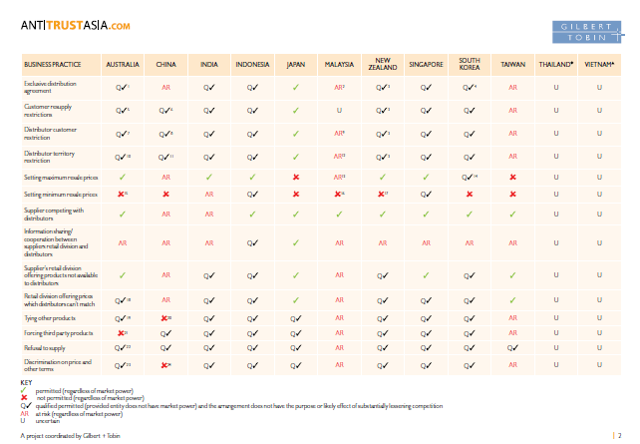

Slide 9
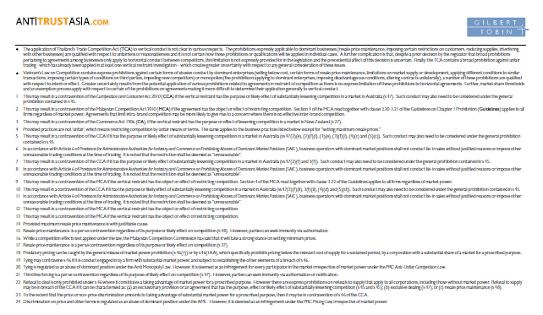

Slide 10
