Slide 1
“CER, competition policy and enforcement cooperation between Australia and New Zealand”
3rd ASEAN-CER Integration Partnership Forum
18 June 2013
Kate Morrison
General Manager Competition
All views are mine and not necessarily those of the Commerce Commission

Slide 2
Outline of presentation
The foundations of effective competition enforcement
Models for cooperation based on the New Zealand and Australian experience
Examples of enforcement cooperation
Case study of cooperation in the development of competition law and policy

Slide 3
The five pillars of effective competition enforcement
1. Right laws are in place
the right prohibitions: against anticompetitive mergers, single firm conduct and collusive conduct
the right powers: to allow the competition agency to properly investigate and take appropriate action
2. Wide range of enforcement tools, right balance between enforcement and advocacy

Slide 4
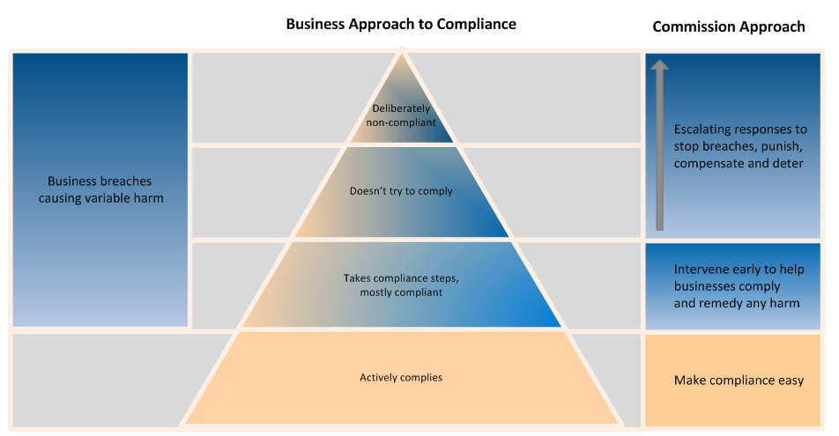
Our approach to achieving compliance

Slide 5
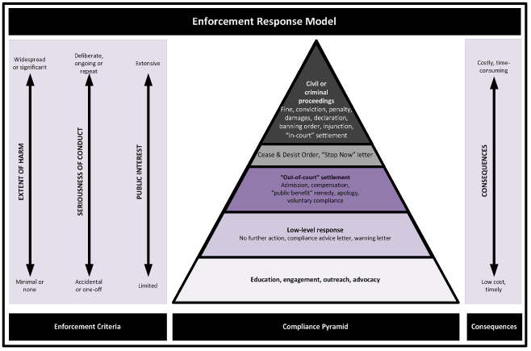
The NZCC’s enforcement response model

Slide 6
The five pillars of effective competition enforcement cont.
3. Government champions competition policy
harnesses the benefits of competition in achieving policy objectives
as far as possible avoids creating barriers to entry and other competition problems
4. Regulator is consistent and predictable
providing certainty about processes and outcomes helps to achieve compliance
5. Effective international cooperation

Slide 7
Why cooperate internationally?
OECD recommends cooperation between competition agencies
Commerce is increasingly carried out across borders
So is collusive behaviour eg global market-sharing
Increases chance of detection of international cartels
Assists agencies to be more effective and efficient

Slide 8
Cooperation between the NZCC and the ACCC
Primarily informal – faster, but depends on a relationship of trust and goodwill between the agencies
Share information informally on matters such as:
timing, scope and progress of investigations
leads on witnesses
how a case is being framed
Coordinate on investigations where possible eg on timing of interviews
Four relevant formal arrangements

Slide 9
Formal cooperation arrangements between New Zealand and Australia
Government to government – MOU on the Coordination of Business Law
Expressly recognises coordination and cooperation in respect of competition enforcement
Businesses should face the same consequences for the same conduct in both countries
Agency (NZCC) to agency (ACCC)
general framework for cooperation, signed in 2007
merger review protocol, signed in 2006
cooperation arrangement regarding the provision of compulsorily acquired information and investigative assistance by the NZCC to the ACCC, signed in 2013
all available on our website www.comcom.govt.nz

Slide 10
Legislative provisions assisting cooperation between the NZCC and the ACCC
Sections 99B – 99P of the Commerce Act – regarding the provision of compulsorily acquired information and investigative assistance by the NZCC
Section 155AAA of the Australian Competition and Consumer Act 2010 – gives the ACCC powers to share information with international enforcement agencies
Mutual Assistance in Business Regulation Act 1992 –allows Australian business regulators to assist international agencies with evidence gathering
Mutual Assistance in Criminal Matters Act – enables domestic agencies to take steps on behalf of overseas agencies carrying out criminal investigations

Slide 11
Examples of enforcement cooperation between the NZCC and the ACCC
Visy cardboard – conducted interviews of Australian individuals at the ACCC offices
High Voltage Cable investigation – coordinated on timing of interviews to avoid limitation period problems
Swedish Match Tobacco merger – coordinated on divestment undertakings
Air Ambulance – NZCC obtained confidential interview transcripts

Slide 12
Case study – criminal sanctions for cartel conduct
Criminal sanctions introduced in Australia in 2009
Remember – government goal of same consequences for same conduct in both New Zealand and Australia
Bill currently before the New Zealand parliament proposing the introduction of criminal sanctions
But there was not simply a wholesale adoption of the Australian position or provisions

Slide 13
Case study – criminal sanctions for cartel conduct cont.
New Zealand carried out an independent and detailed assessment of whether criminal sanctions for cartel conduct were the right option for New Zealand
Decided not to adopt the wording of the Australian offence
difference in legislative style
New Zealand more principle based concepts, Australia more detailed, tailored concepts
Goal of harmonisation achieved while allowing for differences between the two countries
Cooperation between the NZCC and the ACCC enhanced

