Slide 1
TRADE
NEGOTIATIONS

Slide 2
Why?
Notes:
So why do we and our trading partners do trade agreements?
We do trade agreements because we believe increased trade through trade agreements is good for the New Zealand economy and its good for the global economy.
When we and our trading partners open our markets and expose our businesses to increased competition two things happen:
We see a more efficient allocation of resources
And we become more resilient to economic shocks
If you complement that with sound government policies in other areas the result is sustainable and inclusive economic growth. That’s something our Minister is absolutely committed to.
We are a small distant economy, small population base. Trade agreements help us level the playing field with our competitors.
Example: EU – we pay 22% tariff on frozen fish. Our main competitors pay 0%. Not a sustainable situation for New Zealand to be in – need to correct that.

Slide 3
Notes:
In a moment, I will tell you where you can go for more information on New Zealand’s trade agreements and then John will talk about the CPTPP.
Before that I’ll talk a little about the other trade agreements that we’re currently involved in.
Firstly, trade agreements other than the CPTPP…
Even though there is a lot of interest in CPTPP, if you’re interested in CPTPP you should probably also be interested in other trade agreements because they cover some similar issues.
In terms of the trade agreements New Zealand has in force:
One massive trade agreement with around 160 economies - WTO
Another 9 free trade agreements with around 15 economies
Of the free trade agreements that have not entered into force:
Two that have been signed and are being examined by NZ parliament
Five that are currently under active negotiation
One that we hope to launch next month
On to NZ’s various trade negotiations…

Slide 4
PACER
Plus
Notes:
PACER Plus:
Like CPTPP, this is currently in front of the NZ parliament.
With 10 other countries (i.e.: NZ, Australia and 9 Pacific Islands).
Significant development focus. We wanted them to have better access to the New Zealand market but at the same time we didn’t ask them to open their markets to Australia and New Zealand immediately.
That said, it ensures NZ businesses won’t be disadvantaged in the future if our Pacific neighbours do trade deals with others.

Slide 5
RCEP and India FTAs
Notes:
RCEP:
ASEAN, the 3 big North Asian countries (China, Japan, Korea), India, Australia and NZ.
Almost half of world’s population; 7 of NZ’s top 10 export markets; 56% of NZ goods and services exports - that’s over $40 billion of our exports.
Will build on existing FTAs.
If successful, gain preferential access to Indian market for the first time.
Also some improvements in market access in services and for our investors (mainly in ASEAN), and
useful improvements in overarching ‘Rule book’.
China and ASEAN are pushing for conclusion this year. New Zealand also wants to conclude as quickly as possible, but there’s a lot of work to do and we are still seeking a high quality trade agreement.
India:
Two tracks vital for NZ: through RCEP and the bilateral FTA negotiations.
Not clear when the bilateral might conclude. Officials have not met formally since Feb 2015.
But important market for New Zealand so we have kept up active contacts between Lead Negotiators and Trade Ministers.
At present the ball is in India’s court.
Progress will likely depend on India substantially improving its offer to New Zealand on tariff cuts for NZ’s goods.

Slide 6
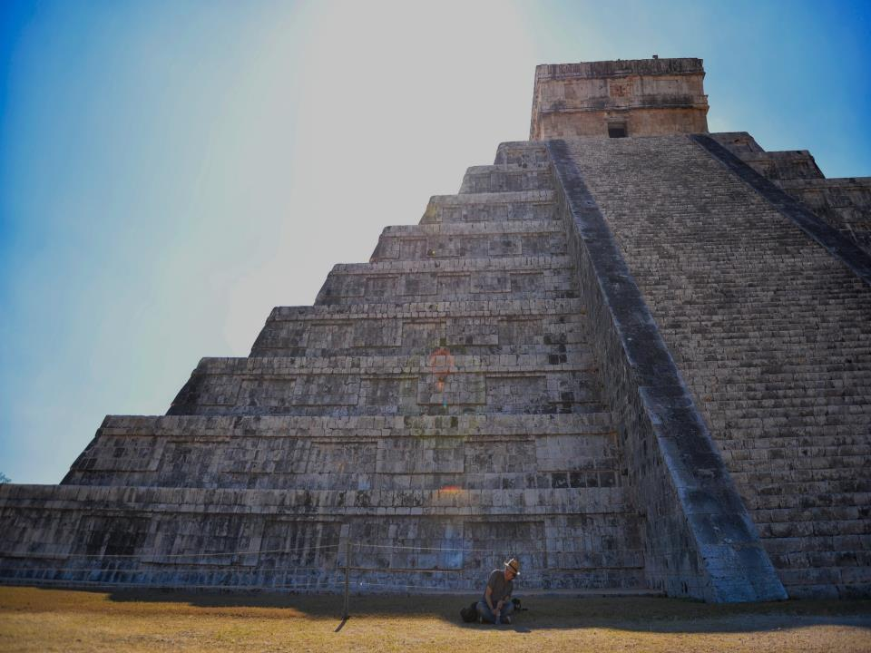
Pacific Alliance
Notes:
Pacific Alliance:
Chile, Colombia, Mexico, and Peru (first FTA with Colombia).
Bloc: world’s 6th largest economy, home to over 220 million people.
Negotiations aiming to conclude this year.
Round going on right now.

Slide 7
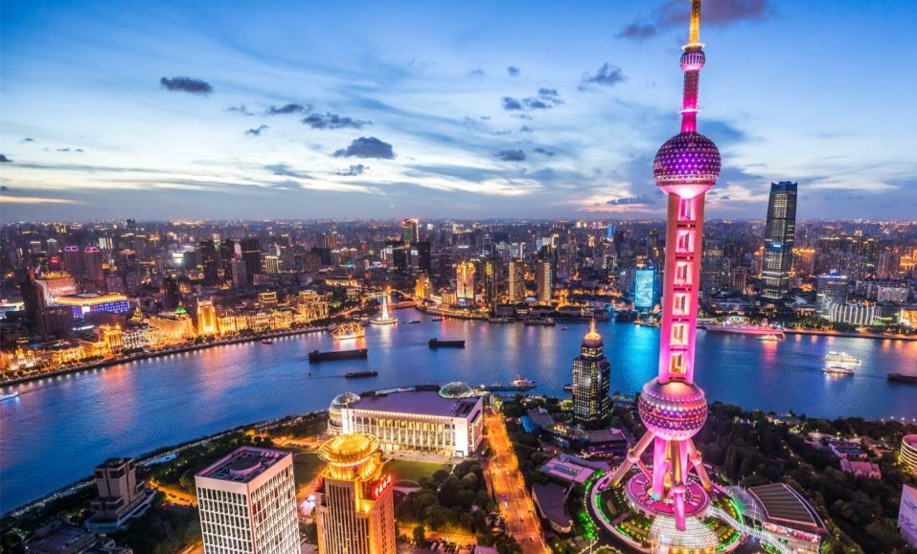
FTA Upgrades: China and Singapore
Notes:
China
We were the first (developed country) to get an FTA with China in 2008, but China has since done trade deals with others giving them faster tariff cuts in some areas. The upgrade is about reflecting this and thus bringing the agreement into line with more recent FTAs
What are some of the issues? We want dairy safeguards removed sooner
We didn’t get tariff elimination on some paper products with China, so that’s unfinished business
Other issues on our agenda include better access for services exports, digital trade and updating the provisions on trade and environment.
Singapore
We are also working with Singapore on something we’re calling an enhanced partnership that includes science, defence cooperation and what is really important in the Singapore-New Zealand relationship – cultural and people to people linkages in both their economic and personal dimensions.
Upgrading the FTA is part of this process.
We already have good market access so we are looking at areas like regulatory barriers to see if we can make life easier for exporters and investors.
We hope to finish negotiations this year.

Slide 8
European Union FTA
Notes:
EU FTA
Highest priority other than CPTPP.
12% of exports and NZD20 billion two way trade.
We can expect some areas to be challenging e.g.:
Intellectual property
Geographical indicators
We think they could be open to negotiating provisions relating to sustainable economic development labour, environment, gender, indigenous peoples, regional development.
It’s looking increasingly likely that negotiations will be launched in June with actual negotiations starting as soon as July.

Slide 9
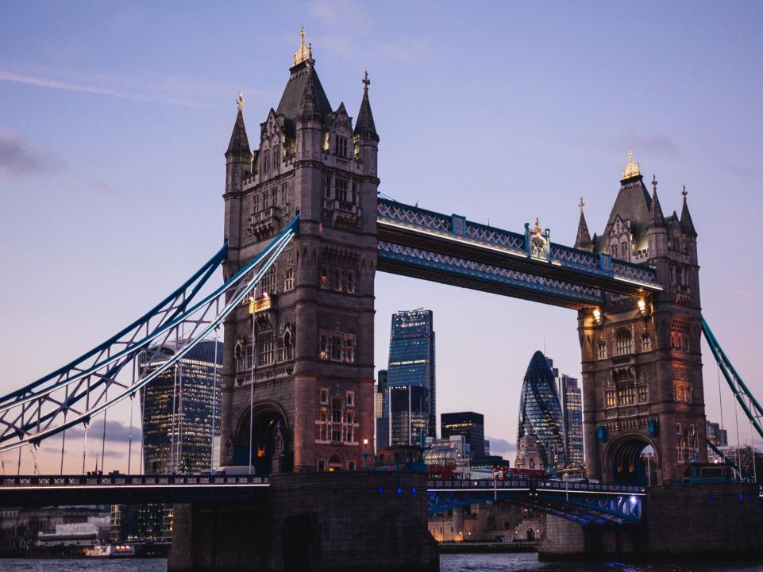
Brexit
Notes:
Brexit
As part of the EU’s WTO commitments to New Zealand, it maintains advantageous quotas for us on lamb, beef, butter and cheese.
We are working to try to make sure that when the UK departs the EU, both the EU and UK live up to their current WTO commitments and do not leave NZ exporters worse off.
We also are working to achieve the objective set by both the NZ and UK govts of negotiations on a UK-NZ FTA as soon as the UK is in a position to do so following Brexit.

Slide 10
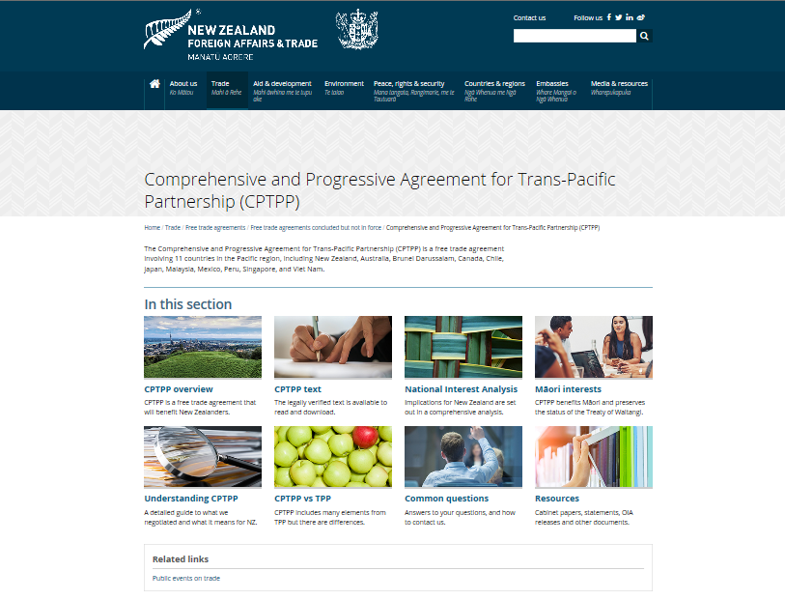
Notes:
Also, if you are interested in those other negotiations you can be getting more information and be giving us your views now. The first step is to go to our website www.mfat.govt.nz.

Slide 11
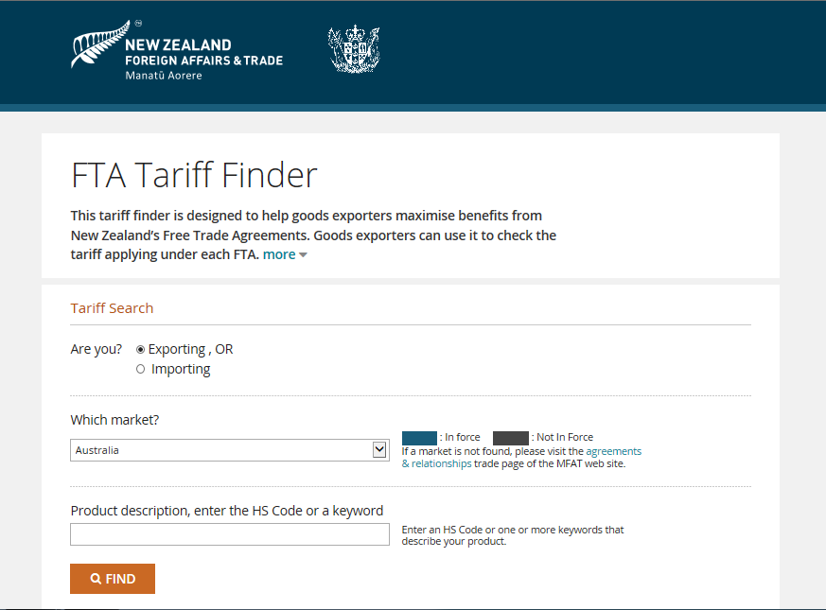
Notes:
For the goods exporters amongst you, you will also find a ‘tariff finder’ on our website. That will tell you the preferential tariff rates you currently face in the markets of each of our FTA partners.

Slide 12
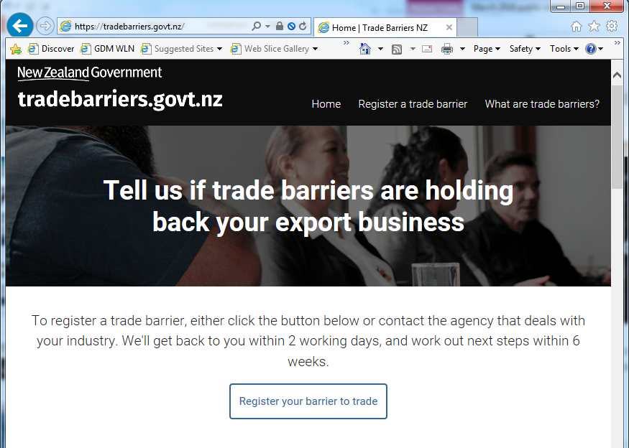
Notes:
I also want to tell you about one more website called tradebarriers.govt.nz. That is a website where you can tell us about a trade barrier that you face in one of your export markets and we will see what we can do to help you fix that. The export market does not have to be a country with whom we have a free trade agreement with.
We’ll provide an initial response within 48 hours. And within 6 weeks we’ll provide you with a plan for how to tackle the barrier you have identified. Sometimes that may involve working with other countries in the market conserned to pursue your issue as a group. And if you’ve identified something which may be a legitimate barrier, we’ll tell you that straight.

Slide 13
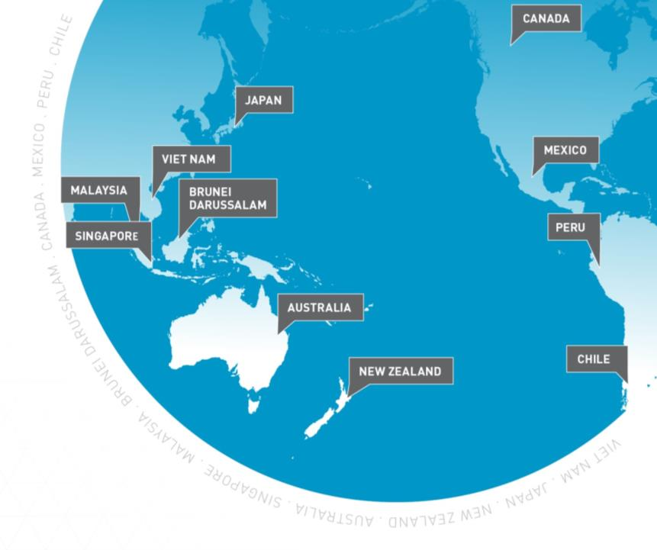
CPTPP
Notes:
Form:
Text of the TPP Agreement has been available since 2015, freely available on our website [www.tpp.mfat.govt.nz]
Negotiations formally concluded on 23 January 2018, and the Agreement was signed on 8 March 2018 in Santiago, Chile.
On 21 February 2018, the full text of CPTPP and the Government’s National Interest Analysis were publically released.
New Treaty is 3-4 pages long and incorporates the TPP Agreement and lists the 22 elements that have been suspended.
Suspended provisions can only be brought into the CPTPP agreement if there is consensus. NZ would have to agree to bring the provisions back into force.
MFAT website explains what those elements are, including what it means for NZ.
We didn’t get everything we wanted – we would have liked more provisions suspended – but in terms of highest priorities we were successful.
Elements that have been suspended relate to the rules of the agreement. Do not affect the market access commitments.
Can be grouped into 2 parts: IP rights and ‘other issues’ (range of other areas – ISDS mechanism, financial services etc.)
Substance:
Important agreement because it keeps NZ in the “group of 11”. Plus the idea is also that CPTPP is not a static agreement, but that other countries will want to join – have already had indications of interest from a number of countries.
CPTPP gives us effectively 4 new trade agreements – countries where we didn’t have FTAs before: Peru, Mexico, Canada and Japan (highest value market for a range of products). It also gives us improvements on all existing FTAs with countries like Chile, Viet Nam, Singapore, Brunei, Australia and Malaysia.
It is different agreement to TPP – different composition for a start, the US is not part of the CPTPP.
Treaty of Waitangi provision is retained.
Pharmac model is still protected.
Government’s right to regulate in the legitimate public interest (the environment, public health, education etc.) is still protected.
Many of the more controversial provisions from the original TPP have been suspended:
Copyright term – the provision which would have extended this to 70 years from 50 years has been suspended. We will be able to keep our system just as it is i.e. (i) lifetime of author + 50 years for written works; and (ii) publication date + 50 years for films and sound recordings.
Biologics.
Pharmac – would have been required to make some administrative changes resulting in a cost of NZ4.5m in the first year followed by annual costs of $2.2m. That part of the agreement has also been suspended.
Mitigation of the risk of ISDS.
When the new government took office, we were given clear instructions that NZ’s position on ISDS had changed.
We were unable to completely extract ourselves from the ISDS mechanism in CPTPP BUT we were able to get five CPTPP countries including Australia to sign a treaty-status side letter that would carve out ISDS between NZ and those countries.
That is particularly significant because 80% of investment that comes from the TPP 11 comes out of Australia.
The other countries that signed were Brunei, Malaysia, Peru and Viet Nam.
Narrowed the scope (private companies who enter into an investment contract with the Government will not be able to use ISDS if there is a dispute about that contract).
Preserved all 11 safeguards (listed on MFAT website). [https://tpp.mfat.govt.nz/assets/docs/TPP_factsheet_Investment.pdf]
Labour and Environment – we wanted to preserve the TPP enforceable set of rules around trade and labour, and trade and environment standards.
Previous similar agreements have not been enforceable – don’t have dispute settlement provisions, ability to impose trade sanctions, ability to impose fines etc. CPTPP is the first and only agreement we have that allows us to do this.
Market access benefits:
Day one of the agreement $92 million worth of tariffs will be saved by NZ exporters when they trade internationally based on current trade flows.
Based on current trade we expect to save $222 million annually when the CPTPP is fully implemented.
Kiwifruit:
Tariff into Japan is 6.4%, Chile pays 0%. Zespri estimates that it will save $26 million a year in tariffs based on current trade alone.
Wine:
Tariff into Japan is currently 15%, Chileans (major competitor of ours) only pay 4.3%.
4th most important market for NZ for wine internationally is Canada, tariff free access into Canada under CPTPP.
Beef:
The current tariff on beef into Japan is 38.5%. Australia has an agreement in place with Japan – has been in place for a year – they pay 27.5% tariff.
According to Beef+Lamb frozen beef exports have collapsed by 70% just in that year as a consequence of the preference that Australia enjoys over us into Japan.
Beef+Lamb NZ have also advised that up to New Zealand 60,000 jobs depend on world openness to our beef and lamb products.
EU – another major beef exporter (28/27 countries) – have also concluded a FTA with Japan, so we expect that very quickly they will also have tariff preference over us.
CPTPP immediately levels the playing field – on Day 1 of the agreement coming into force we immediately have parity with Australia.
Next steps:
In order for the agreement to come into force we need 50% of the original CPTPP signatories to ratify the agreement through their domestic parliamentary procedures, and then the agreement comes into force for those countries that have ratified.
Important change over the original TPP which had a GDP threshold.
The NZ consultation process is ongoing. We will report to Ministers what we heard from you today.
Parliament has two opportunities to consider the CPTPP:
There is a proper treaty examination in accordance with Parliamentary Standing Orders, and a Select Committee that then reviews the agreement. This process has been under way since mid-March 2018, and included a public submissions process conducted through the Foreign Affairs, Defence and Trade Committee (FADTC) of parliament. [https://www.parliament.nz/en/pb/sc/scl/foreign-affairs-defence-and-trade/]
Parliament has another opportunity when the legislation to bring the agreement into force is put to Parliament for debate.

Slide 14
Tēnā koutou
katoa
Notes:
Tēnā koutou katoa

