Slide 1
Current trade negotiations
INVERCARGILL / WAIHŌPAI – SEPTEMBER 10
Picture: Venture Southland

Slide 2
How can we help?

Slide 3
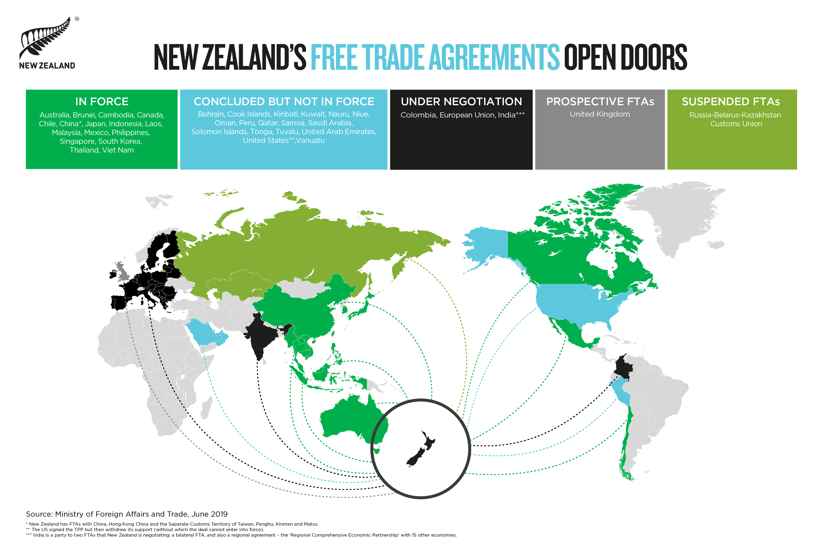
Notes:
Of course the EU is not the only market New Zealand exports to...

Slide 4
Tariff Finder
Look up tariffs for export markets
Recently expanded to cover all NZ’s FTA markets and 136 non-FTA markets
Also allows you to look up HS Codes
Notes:
Once at FTA enters into force - our work doesn’t stop. Want to make sure as many businesses as possible are getting the benefits.
With the recent upgrade of tariff-finder, exporters now have access to a one-stop-shop for tariff rates in the 20 markets with which we have free trade agreements, plus an additional 136 markets.
The upgrade of this online tool is in response to exporters who said being able to find all this information in one place would make it easier and faster to compare and assess opportunities when planning export development strategies.
Exporters also asked for explanations of the many acronyms and abbreviations used in international trade, which have also been added to the tariff-finder site.

Slide 5
Report export issues
email: exports@mfat.net
call: 0800 824 605
Or visit tradebarriers.govt.nz
We guarantee a response within 2 working days
Free service
Notes:
And the FTAs may not be the answer
tradebarriers.govt.nz - website where you can tell us about a trade barrier that you face in one of your export markets and we will see what we can do to help you fix that.
The export market does not have to be a country with whom we have a free trade agreement.
We’ll provide an initial response within 2 working days unless it is urgent and we will give it priority. And we will respond with next steps within 6 weeks.
Sometimes that may involve working with other countries in the market concerned to pursue your issue as a group.
And if you’ve identified something which may be a legitimate regulation, we’ll tell you that straight.

Slide 6
Current Trade Negotiations

Slide 7
Under negotiation
China FTA Upgrade
AANZFTA Upgrade
RCEP
Pacific Alliance
EU-NZ FTA
WTO E-Commerce
Digital Economy Partnership Agreement
Notes:
Regional Comprehensive Economic Partnership(RCEP ):
ASEAN, the 3 big North Asian countries (China, Japan, Korea), India, Australia and NZ.
Over half of world’s population.
RCEP economies take about 56% of New Zealand’s total exports, so it is an important table for NZ to be sitting at.
Will build on existing FTAs.
If successful, gain preferential access to Indian market for the first time.
And the chance to improve conditions for our services exporters and our investors, as well as to improve some aspects of the ‘rule book’ e.g. on SPS measures.
China and ASEAN countries are pushing for conclusion this year. New Zealand also wants to conclude this year but there’s a lot of work to do and we are seeking a high quality trade agreement.
Pacific Alliance:
Chile, Colombia, Mexico, and Peru (first FTA with Colombia).
Bloc: world’s 6th largest economy, home to over 220 million people.
Negotiations aiming to conclude this year.
China
We were the first (developed country) to get an FTA with China in 2008, but China has since done trade deals with faster tariff cuts in some areas. The upgrade is about reflecting this and thus bringing the agreement into line with more recent FTAs
We didn’t get tariff elimination on some paper products with China, so that’s unfinished business
Other issues on our agenda include better access for services exports and updating the provisions on trade and environment.
ASEAN-Australia-NZ FTA (AANZFTA) Upgrade
Originally concluded in 2008
Upgrade negotiations launched in May 2019
Scope will cover most areas apart from goods or intellectual property.
But neogtiations in most areas unlikely to get seriously underway until RCEP concludes.
Overseas Investment Act Reform (If asked)
If asked points on OIA reform:
• The Government has just finished consulting on proposed reforms of the Overseas Investment Act 2005. The proposals are part of a second phase of reform of the Overseas Investment Act. (The first phase been bringing residential property within the scope of the Overseas Investment Act and streamlining of rules around investment in forestry.)
• Reform proposals being considered as a part of phase two are focused on removing red tape and achieving a balance between supporting high quality overseas investment in productive assets, and ensuring investments are in our national interest.
• The Government is now considering feedback from consultation. Legislation to implement the review’s recommendations is planned for passage by mid-2020

Slide 8
Brexit
Regulatory continuity
Preserving access
UK – NZ FTA
Notes:
Brexit and a UK FTA
From the outset, the government has been focused on working to promote stability and continuity through the Brexit period and pursuing opportunities to strengthen our trade and economic relationship with the UK post-Brexit. This has involved three main areas:
Protection of Goods Market Access
New Zealand is working actively at the WTO and bilaterally to do everything it can to protect existing New Zealand access into the EU and the UK.
The major area of concern that has arisen is a proposal by the EU and UK to split the WTO tariff rate quotas for a range of agricultural products post-Brexit. This would remove the flexibility exporters currently have in where they send their product in response to fluctuations in market demand, undermining the quantity and quality of the existing WTO market access commitments the EU/UK have made;
The government has taken every opportunity to raise this issue with UK and EU counterparts and continues to press them to follow through on the assurances they have given that other WTO Members, like New Zealand, will not be left worse off as a result of Brexit;
We are also working hard to defend this existing access in technical discussions and possible future negotiations in Geneva;
At the same time, we have been seeking clarification on practical matters, e.g. documentation requirements, which could arise in a ‘no deal Brexit’ scenario.
Regulatory Continuity
Working to ensure the continuation of the regulatory arrangements underpinning our trade with the UK has also been a key area of focus.
On 21 January 2019, we signed agreements providing this continuity for our Veterinary Agreement covering the export of animals and animal products; as well as an MRA on Conformity Assessment covering seven manufactured goods sectors;
These are intended to enter into force once the UK leaves the EU – either immediately, in the case of a ‘no deal Brexit’, or at the completion of any transition period during which the UK remains a part of the Customs Union
In other regulatory areas where New Zealand has EU recognition of equivalence, the UK has also said it intends to continue to recognise this (organics equivalence, IUU fisheries catch certification, inspection checks for fresh fruit and vegetables and data adequacy).
UK FTA
Both the UK and New Zealand have indicated publicly their intention to negotiate a high quality, comprehensive, bilateral FTA, as soon as the UK is in a position to do so.
To help lay the groundwork for these negotiations, the UK held a round of public consultations which concluded in late October and New Zealand also called for public submissions last November. This closed in February.
The UK recently released a summary of its public consultations, which was as we expected – including concerns about access from competitive New Zealand agricultural products.

Slide 9
European Union – New Zealand Free Trade Agreement

Slide 10
The opportunity
World’s largest trader
NZ’s 3rd largest partner
$22 billion two-way trade
Notes:
An FTA with the EU is one of the top of the Government’s trade priorities. Not just because the EU is an important trade and economic partner but because of the breadth and depth of the relationship that we enjoy
But in the trade sphere, it’s our third-largest trading partner (after China and Australia), with $23 billion of two way trade in 2018. Even without the UK, two—way trade amounts to $15 billion. And our second largest trading partner if you look at services. In 2018, the EU accounted for over 14% of NZ’s total trade.
The EU is the world's largest trader of goods and services. It is also the world's largest single market area - an area where people, goods, services and capital can move freely.
Until now, New Zealand has been one of only half a dozen WTO members not to have an FTA or launched negotiations with the EU. This puts New Zealand businesses at a significant disadvantage against global competitors.
After nearly nine years of discussion, negotiations were officially launched by EU Trade Commissioner Malmström and NZ Trade Minister Parker in June last year.

Slide 11
Shared trade outlook
Trade for All agendas
Sustainability
SMEs
Gender & Indigenous Issues
Notes:
Despite differences over agricultural trade, the EU and NZ are very like-minded on many other trade issues and are heavily committed to the rules-based trading system.
The EU also shares New Zealand’s commitment to a progressive trade policy that benefits all citizens. We call this agenda “Trade for All”. In fact, New Zealand ministers borrowed the name from the EU’s Trade for All policy, which dates from 2015. The TFA Advisory Board has not yet reported to the Government, but because we are in negotiations – we have made a start. And we have said to the EU that we will likely have further ideas to bring to the table.
We want to set a new benchmark for provisions relating to sustainable economic development (including our climate change objectives under the Paris Agreement), labour, and the environment.
We will explore how the trade aspirations of women and Māori can be supported by the agreement. And we want to see how we can promote the interests of SMEs and the regions.
Provisions for the EU-NZ FTA recognising the rights and aspirations of Māori are currently being discussed with the EU. It is fair to say that this has been hard going so far because the EU sees no scope for an indigenous to indigenous relationship. We are seeking to convince them that it is about the EU recognising Māori interests in the relationship and them being prepared to work with NZ to see these accommodated.

Slide 12
What we’re negotiating
Agricultural market access
Services
Intellectual Property
Notes:
While there are many areas of commonality in our approaches to FTAs, we can expect some areas to be challenging.
Agricultural market access – New Zealand’s approach in all trade agreements is to seek comprehensive tariff elimination for all goods, while the EU’s sensitivities with respect to certain agricultural goods are well known.
We will seek an ambitious agreement that levels the playing field with the EU’s other FTA partners. Currently we discriminate against each other due to the FTAs we have done with other partners.
We will be guided by the principles of fairness and reciprocity. For primary products, New Zealand producers face high tariffs and quota restrictions in the EU market, in contrast to the open access that EU producers face when exporting to New Zealand. This disparity needs to be addressed.
But it is not all about agricultural access. We want to know what other barriers New Zealanders are facing for all goods as well as services and in the area of government purchasing.
The EU and NZ both have strong, efficient and effective Intellectual Property regimes. However the EU wants to lengthen the effective terms of protection. By this I mean issues like copyright term, provision for patent term extension and term of data protection especially for biological pharmaceuticals.
What we do currently in NZ works from our perspective. While we don’t yet know exactly what the EU’s priorities are, we are alert to the potential costs of change and will not agree to a deal that is not in the overall national interest.
In earlier scoping, NZ insisted (and the EU eventually agreed) that we needed to address issues relating to genetic resources, traditional knowledge and cultural expressions in the negotiations. An imperative for negotiators is to continue to preserve policy space for the Crown to provide protection for Māori rights and interests under the Treaty of Waitangi in this area.
On pharmaceuticals, the Government has said it is committed to ensuring that the Pharmac purchasing model remains protected, including its ability to negotiate the best prices for medicines for New Zealanders.

Slide 13
What we’re negotiating
Geographical Indications (GIs)
Government Procurement
Notes:
A few words on geographical indications – a major EU offensive interest. These are the names attached to goods, such as wine and spirits and to some foods, that indicate a quality or reputation linked to where the goods are from. The EU is seeking protection under the agreement for some 2100 names, most of which are for wine. (New Zealand already has legislated protection for wine and spirit GIs but not for food.) Where the interests of the EU and NZ intersect for food products is for certain cheeses. Think Feta!
We agreed in scoping discussions with the EU that the Agreement should consider the protection of geographical indications which would cover food and foodstuffs, but only if there is a satisfactory overall outcome in the Agreement for New Zealand.
That means market access for NZ, including on the very same food products. The detail of any such framework will be addressed in the negotiations.
In the meantime we have sought input from New Zealanders on the list of GIs that the EU wants protected in the FTA as well as any GIs that NZ should propose - e.g. our current wine GIs and any other food which might currently have protection in NZ through a (collective) certification trade mark.
There will be provision to add names as we go and after the negotiations are completed. E.G. if Manuka Honey gains a certification trade mark, then it could also be proposed as a GI.
Consultation on an expanded GIs regime for NZ will need to take place alongside the negotiations and any issues relevant to Māori can be discussed and taken into account.
On Government procurement, New Zealand already has commitments under the WTO GPA and under other FTAs to offer non-discriminatory treatment to many other supplying countries, including the EU (for purchasing above a value threshold by government entities covered by the agreements, currently at about NZ$400,000)).
However the negotiations will go beyond this, looking to increase the coverage of the agreement. The EU has indicated that it is interested in greater commitment from NZ at the local government level. This will be for negotiations.
An important point to underline is that whatever the scope of commitments made in the FTA, government purchasing bodies won’t be prevented from taking into account environmental and social considerations throughout the procurement procedure, as long as they don’t discriminate against FTA partners.

Slide 14
Other issues
No investment disputes (ISDS)
Right to Regulate
Treaty of Waitangi
Notes:
One area which won’t cause issues in the negotiations is Investor-State Dispute Settlement. This is not included in the EU’s mandate for negotiations, so is not on the table. (New Zealand’s policy is now to oppose the inclusion of ISDS in trade agreements.)
Right to regulate – trade deals don’t stop us from protecting our health, environment or Treaty of Waitangi partnership – there are a number of tools we use to preserve the right to legislate in the public interest, such as general exceptions and reservations. They will all be included in this FTA.
The EU also is clear on this point and EU Trade Commissioner Malmström underlined this point a number of times when she was in NZ in June.
The EU has also already agreed to include New Zealand’s Treaty of Waitangi exception clause in the FTA to safeguard the interests of Māori. The EU’s negotiating mandate is precise on this point.

Slide 15
E-commerce: WTO negotiations
80 members
New rules
Personal privacy, consumer protections, transparency and openness
Notes:
New Zealand is taking part in negotiations to establish global e-commerce trade rules at the World Trade Organization (WTO).
New Zealand is one of 80 members representing more than 90 per cent of global trade that are participating in these negotiations.
These negotiations are not about starting from scratch, but building on existing trade rules, commitments and exceptions at the WTO that have not kept pace with contemporary trading realities.
E-commerce and digital trade is especially important to small businesses located in a geographically remote country – New Zealand! - as it enables them to participate in cross border trade, helping to overcome the challenges of scale and distance.
WTO Members have been meeting to discuss the scope and substance of an outcome on e-commerce. We were particularly pleased by the high levels of engagement at the first set of meetings in Geneva in mid-May.
And New Zealand proposals (on paperless trading and e-invoicing) got a good level of engagement in the session last week, 15-19 July 2019.
Our key focus is on developing trade rules that will deliver more certainty and predictability for small and medium-sized enterprises engaged in digital trade, and reducing costs and confusion when trading online. The process is relevant for all forms of businesses including those selling physical goods as well as digital services.
Our participation in these negotiations will ensure we can strongly advocate for issues that New Zealanders care about, such as the need for robust personal privacy and consumer protections, transparency and openness.
This is an opportunity for members to work together to develop globally consistent rules around e-commerce which are fair and which work to the benefit of our respective communities.
Some members are also asking whether we should negotiate to improve market access for relevant services to support e-commerce and digital trade

Slide 16
E-commerce: DEPA Digital Economy Partnership Agreement
Singapore and Chile
Shape global norms
Pathfinder
Notes:
Digital Economic Partnership Agreement (DEPA)
On 17 May in Chile, Minister Parker - together with Ministers from Chile and Singapore - announced commencement of negotiations towards a Digital Economy Partnership Agreement (DEPA).
These negotiations are an opportunity for New Zealand to help shape global norms for digital trade and the digital economy. The parties hope to create an agreement that will act as a pathfinder in relation to the WTO negotiations and other digital economy work under way in international forums.
The intention is to consider all aspects of the digital economy that might support trade in the digital era, building on existing trade agreement commitments in e-commerce chapters such as the CP TPP.
More information is available at www.mfat.govt.nz/depa.
We want to hear from New Zealanders to help shape our approach to negotiations on both of these digital negotiations. Submissions on the DEPA closed on 1 July but you can still email us at e-commerce@mfat.govt.nz to share your views and register your interest in future engagement opportunities.

